Slide 1
What would a perfect world look like?

Slide 2
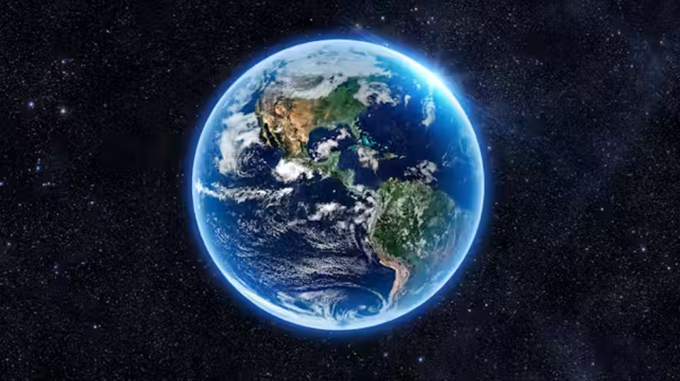

Slide 3
In a perfect world there would be nice people being happy.

Slide 4
In a perfect world there would be kindness.

Slide 5
In a perfect world there would be loads of love.

Slide 6
In a perfect world people would respect each other.

Slide 7
In a perfect world there would be no fighting

Slide 8
In a perfect world we would all be free.

Slide 9
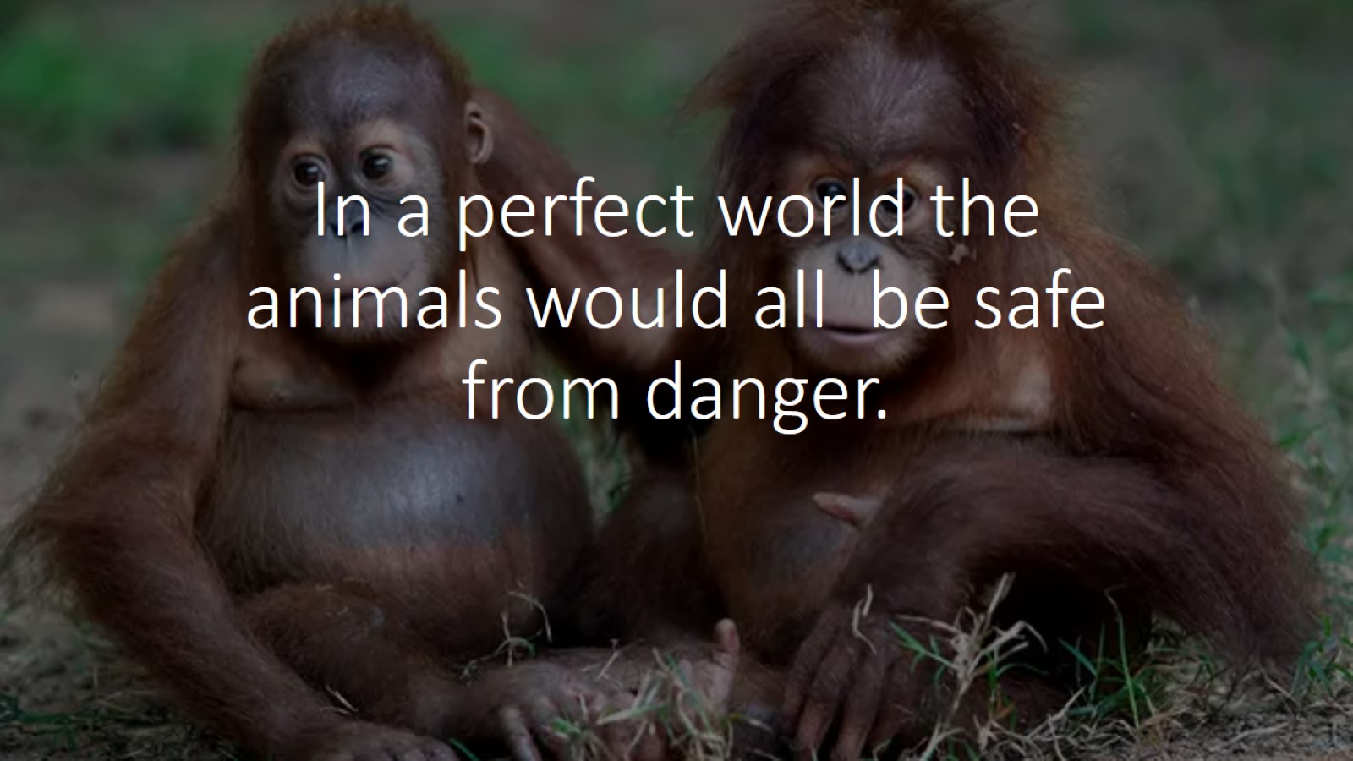
In a perfect world the animals would all be safe from danger.

Slide 10
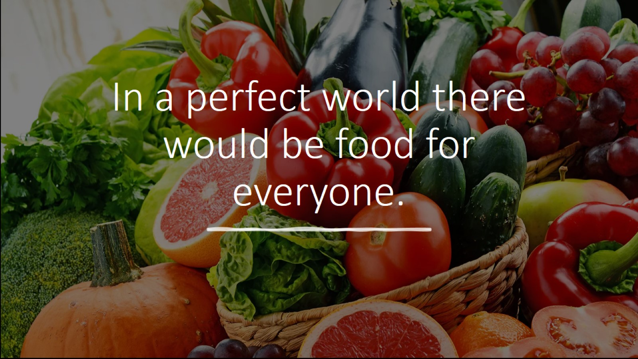
In a perfect world there would be food for everyone.

