Slide 1
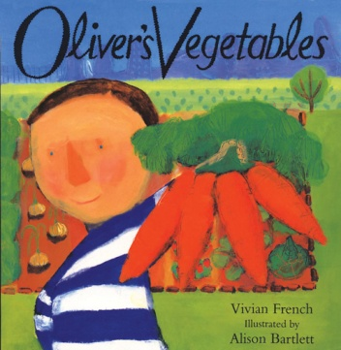
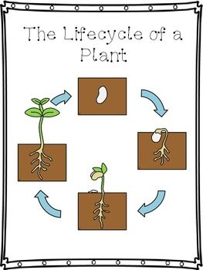
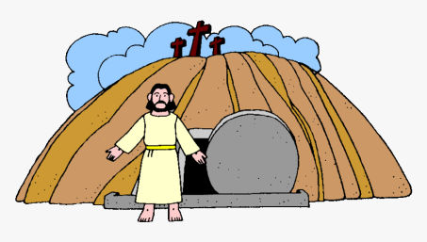
People & Communities
Mothering Sunday
World Book Day
Communication, Language & Literacy
Supertato
Oliver’s Fruit Salad
Expressive Arts & Design
Painting fruit and Vegetables
Spring Flowers painting and making
Painting Characters from stories
Maths
Numbers 1-5
Linking numerals to amounts
Weight
Length
Height
I wonder what is new?
Nursery Spring 2 2024
PSED
Tick Box – Doodle Makes Choices - Communication
The World
Spring Time Changes
The Life Cycle of a Plant
Physical Development
Sports Xplorers
Balancing Bella
RE
Easter

